Slide 1

Park n' Go
Nina Yang
Alex Huttunen
Jisoo Jung
Rajdeep Singh

Slide 2
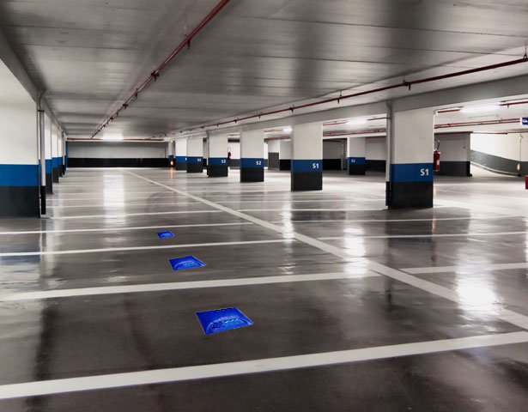
Overall Idea
Sense cars in individual parking spots
Sensors placed under vehicles
Sensors are wireless
Base station placed on each level
Information available via the internet

Slide 3
System Architecture
Magnetometer
Si4010 Microcontroller
GNURadio
Graphical User Interface
Frequency Shift Keying (FSK) Signals
Web Server and Database

Slide 4
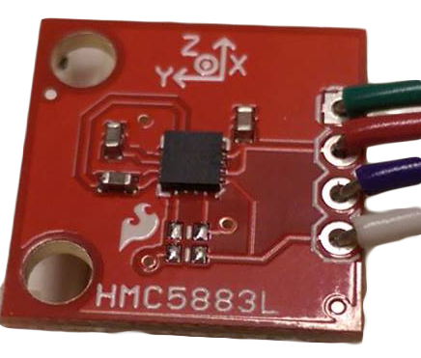
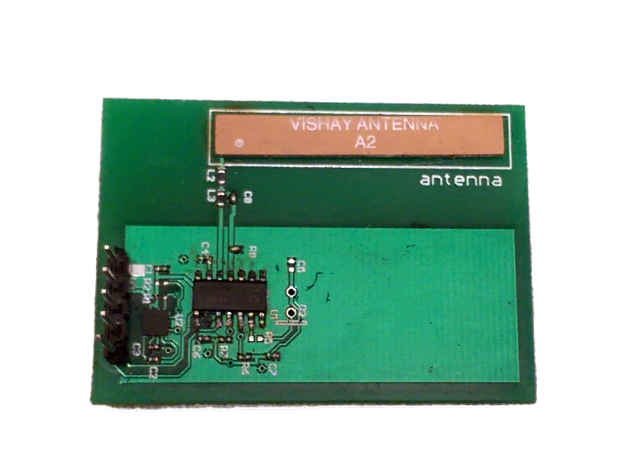
Sensor: Magnetometer
Measures disturbances in the magnetic field
Almost all vehicles are made of or contain metal of some sort
Place one at the end of each parking spot to detect the car passing into the spot or out.
NXP (a semiconductor manufacturer) has tested this use case and found that it works [1].
[1] http://blog.nxp.com/connected-car/howto-detect-vehicle-presence-or-movements-with-magnetometers/

Slide 5
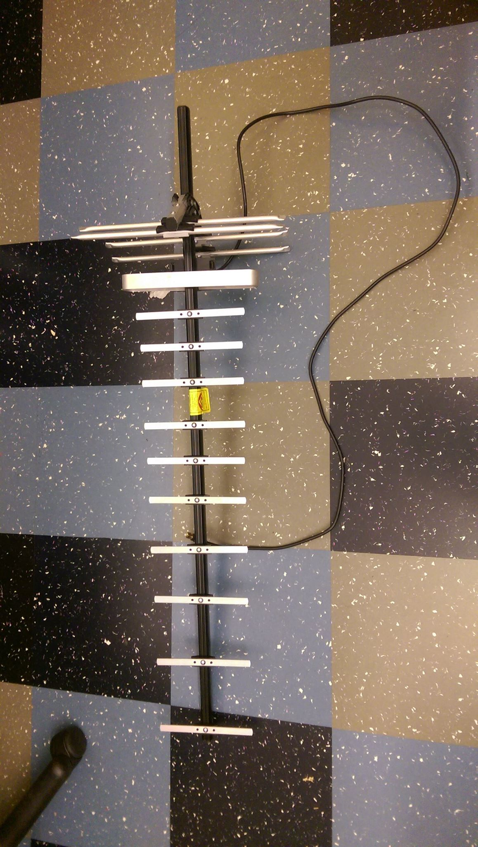
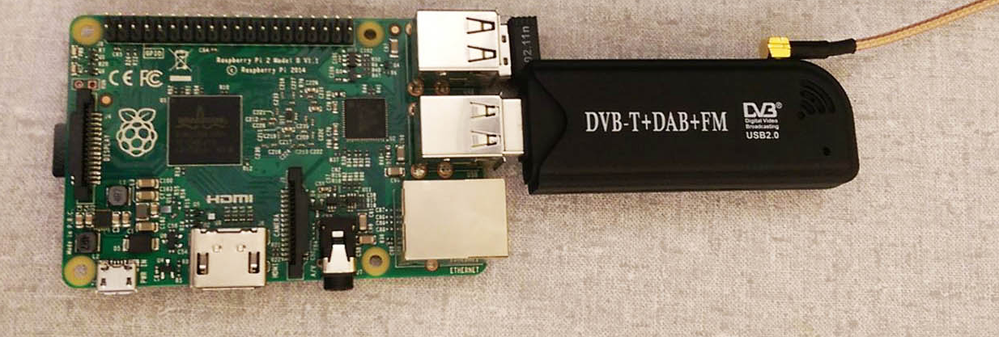
Base Station Communication
FSK Radio Signal
433 MHz (but configurable)
Received by RTL2832U
TV Tuner - $10.80
Used as Software Defined Radio
Processing done on Raspberry Pi
Radio decoding done in Python
Takes radio packets and displays them using a webserver.
Connected to Internet via Ethernet or WiFi

Slide 6
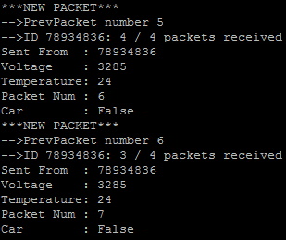
Packet Receive – Console Output
Each sensor has a unique ID
Battery voltage
Know battery life
Temperature
Packet number
Signal strength
Car detection result
Sent at regular intervals

Slide 7
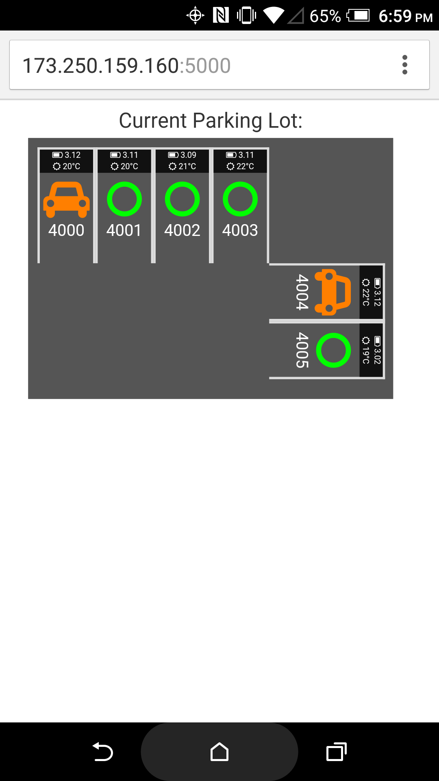
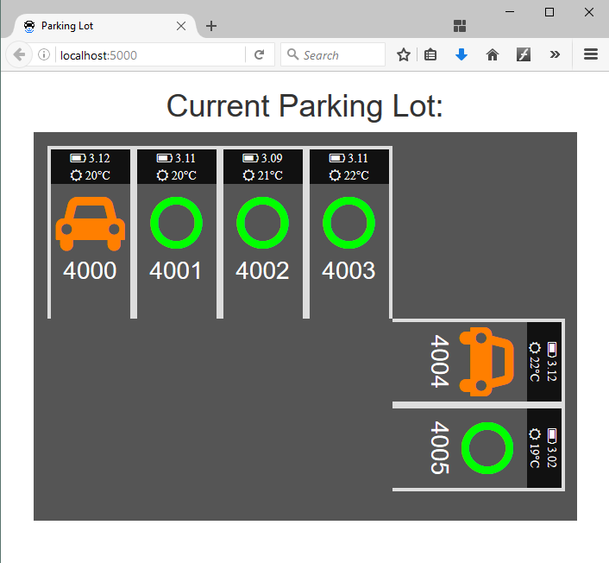
User Interface

Slide 8
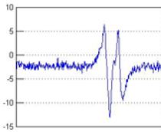
Vehicle Detection
Initial detection approach – detect sudden changes in the signal.
This approach worked, however, there were some limitations.
Limitations were:
It required the system to be powered 24/7.
Algorithm itself was complicated.
We needed an algorithm that would be power efficient.

Slide 9
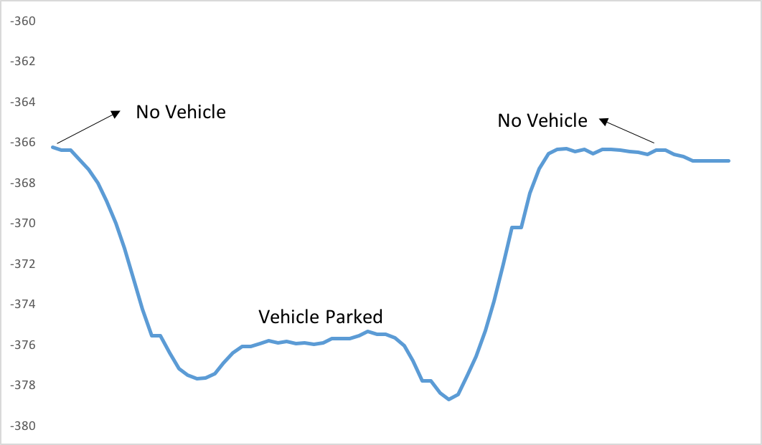
Vehicle Detection
Get Calibration Data
Calculate signal average (in x, y, z direction)
during initial setup
Calculate Threshold
Multiple trials to calculate threshold
Calculate Signal Difference
If (current signal – signal average) > threshold
vehicle is present
This algorithm does not requires system to be powered 24/7 and is less complicated.
Graph of magnetometer reading
Mag
Threshold

Slide 10
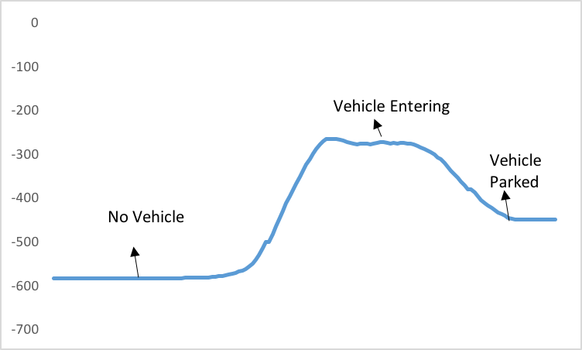
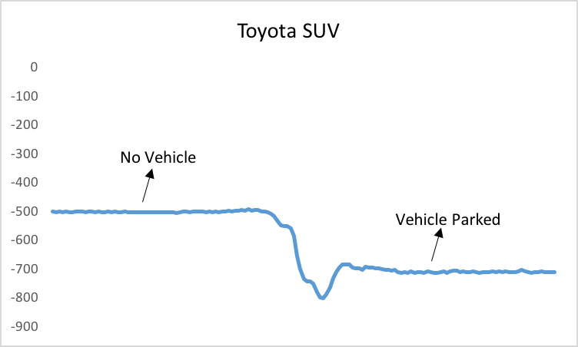
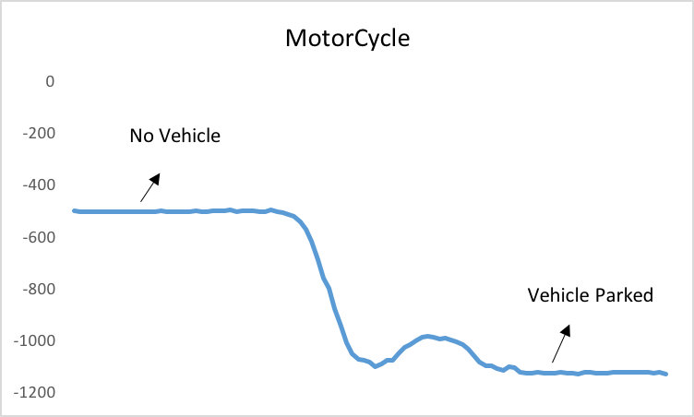
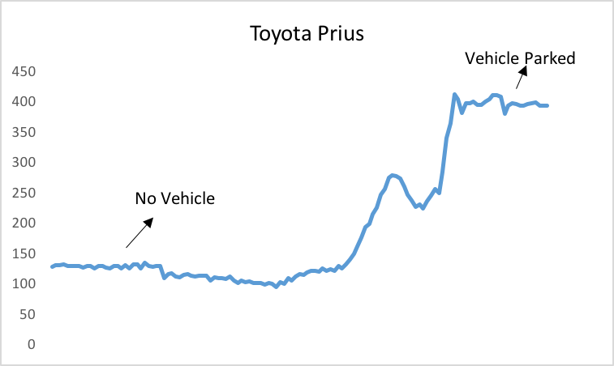
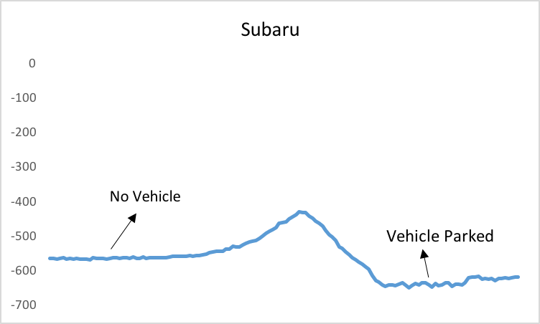
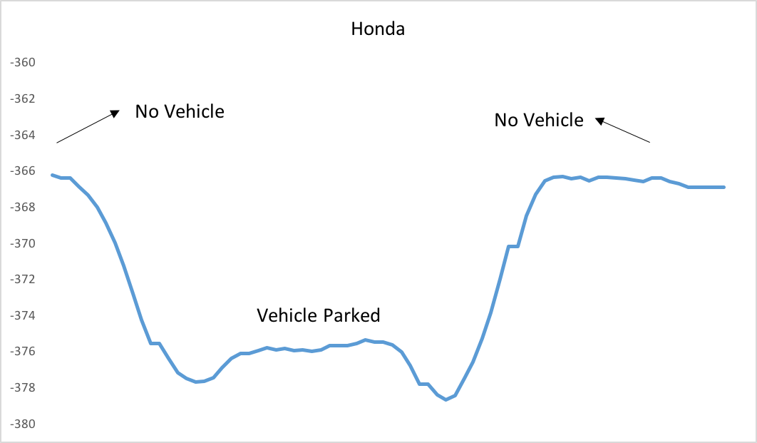
Detection Results
Hyundai

Slide 11
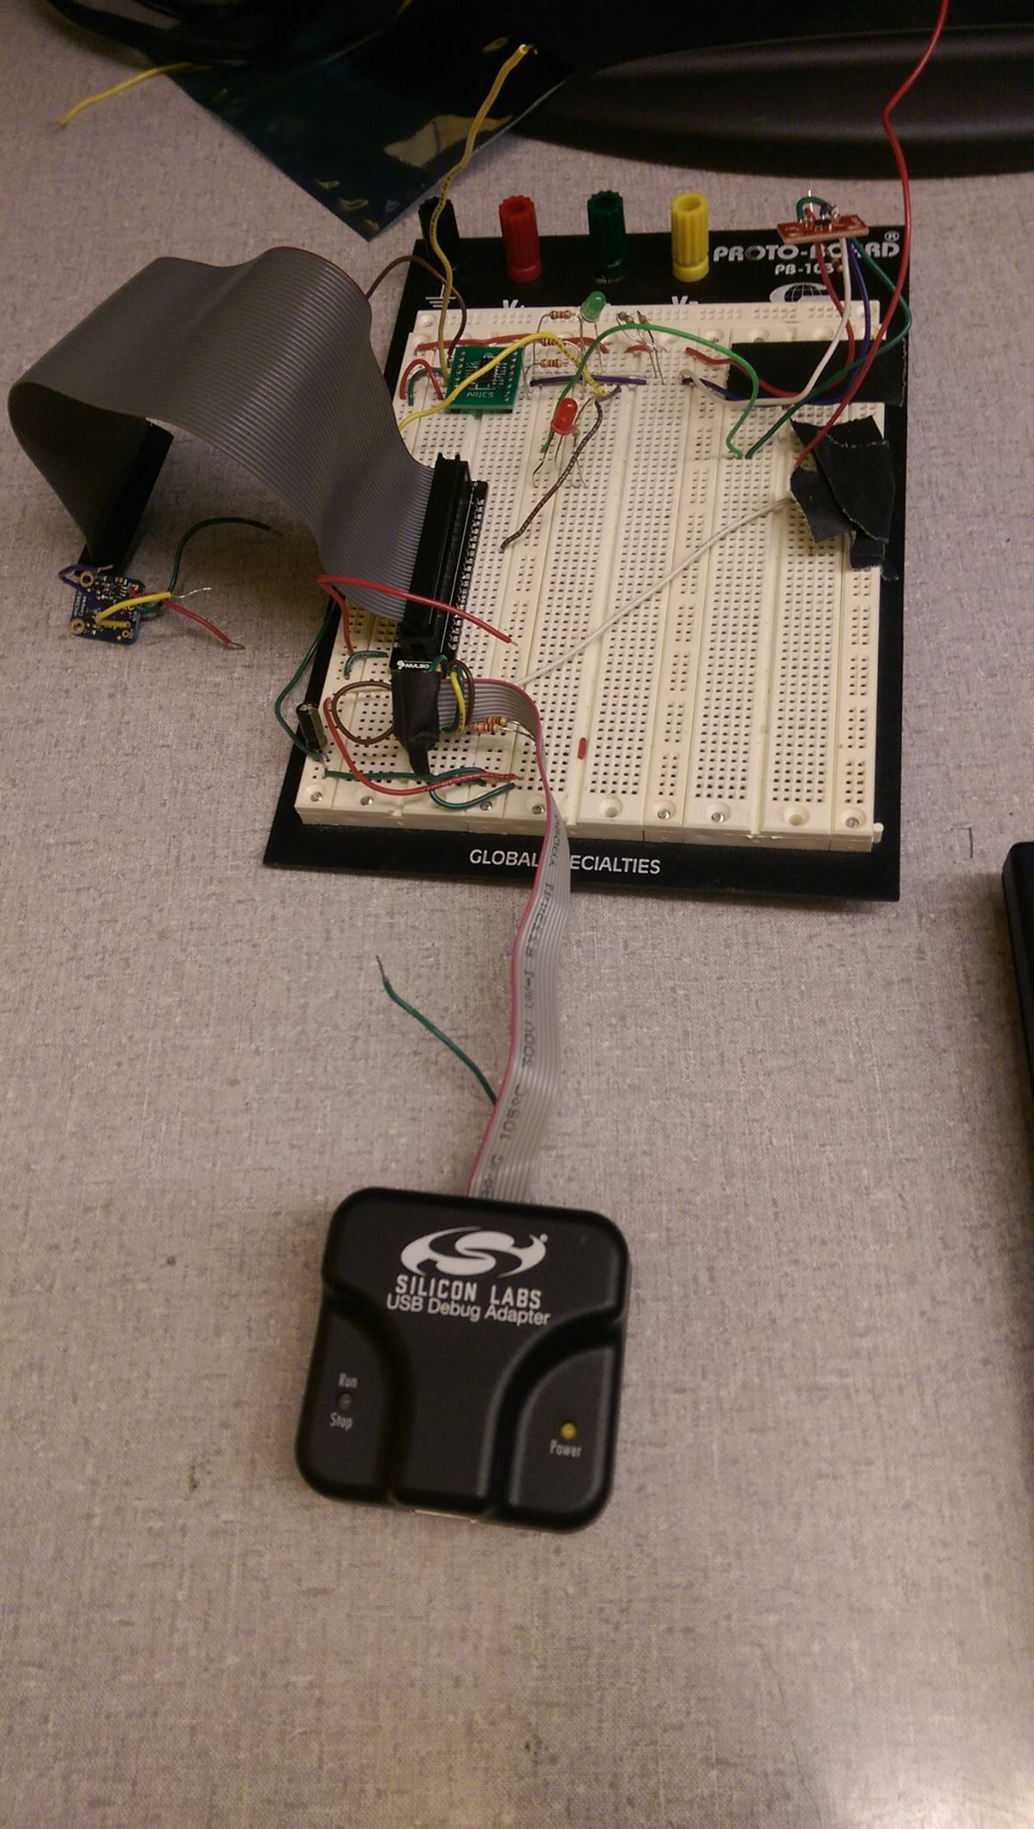
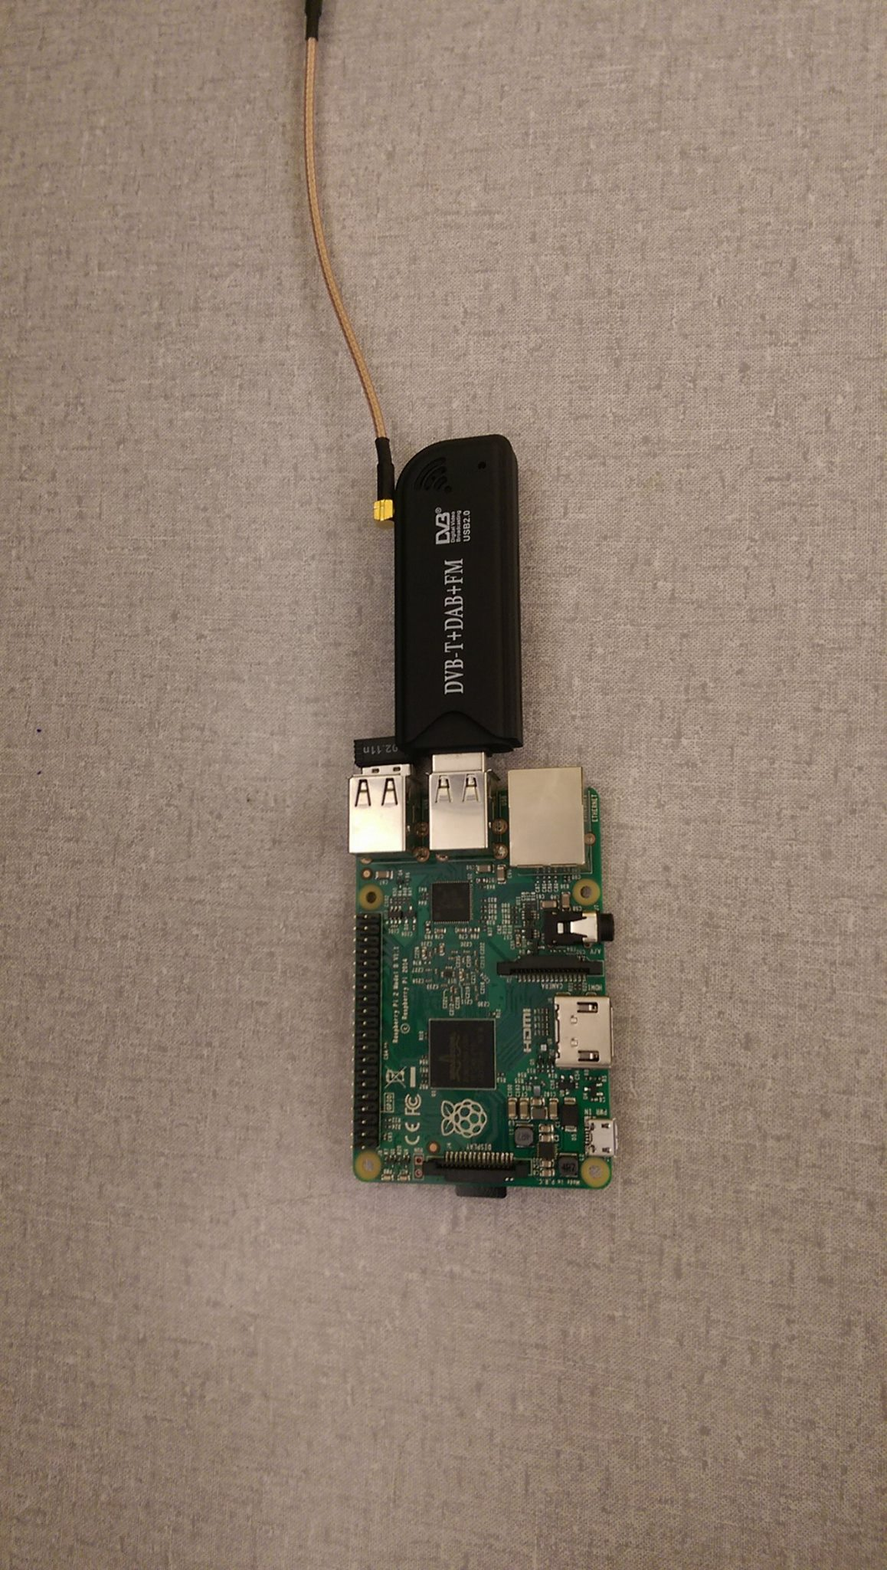
Development Environment

Slide 12
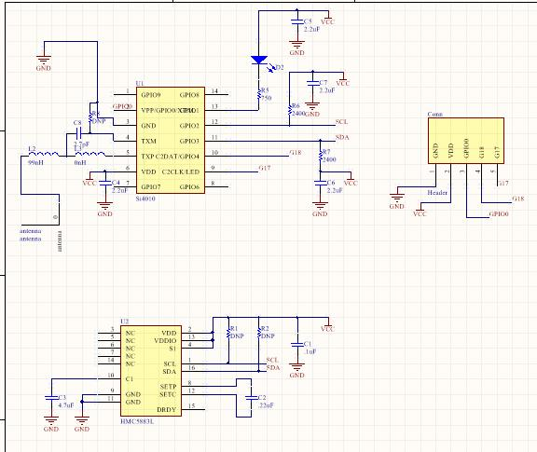
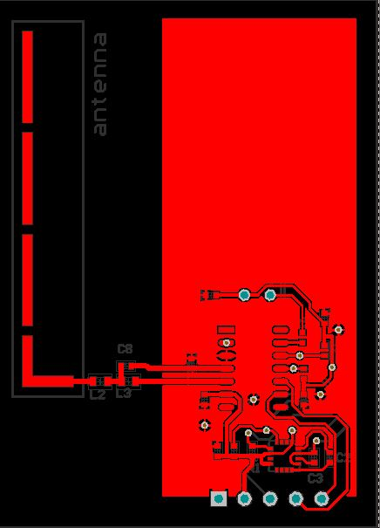
PCB Design

Slide 13
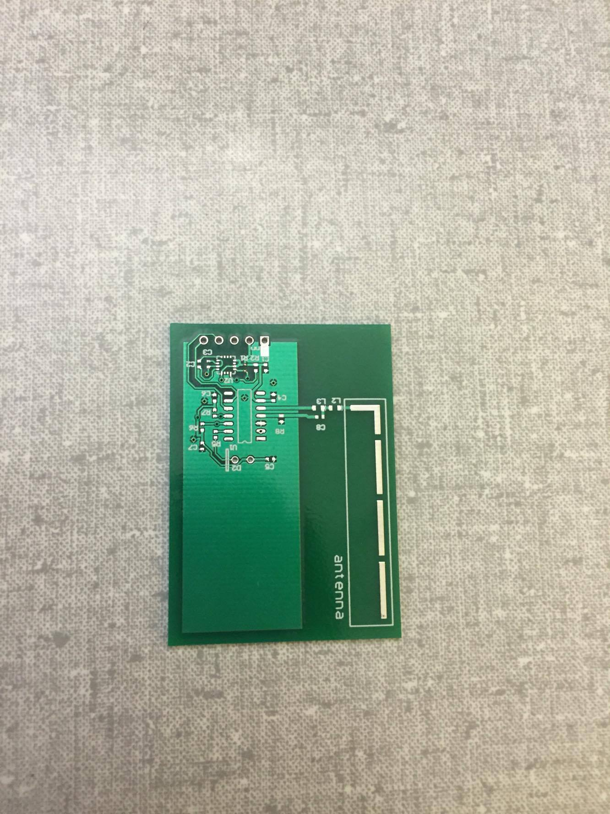
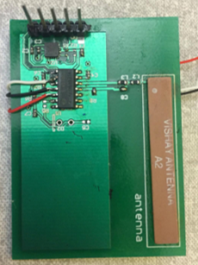
PCB (without/with soldered components)

Slide 14
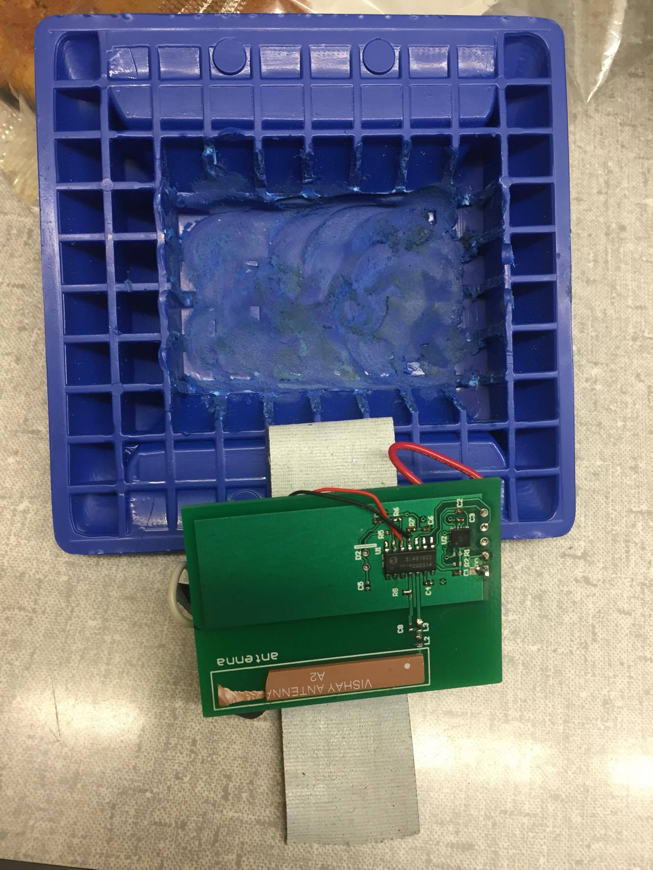
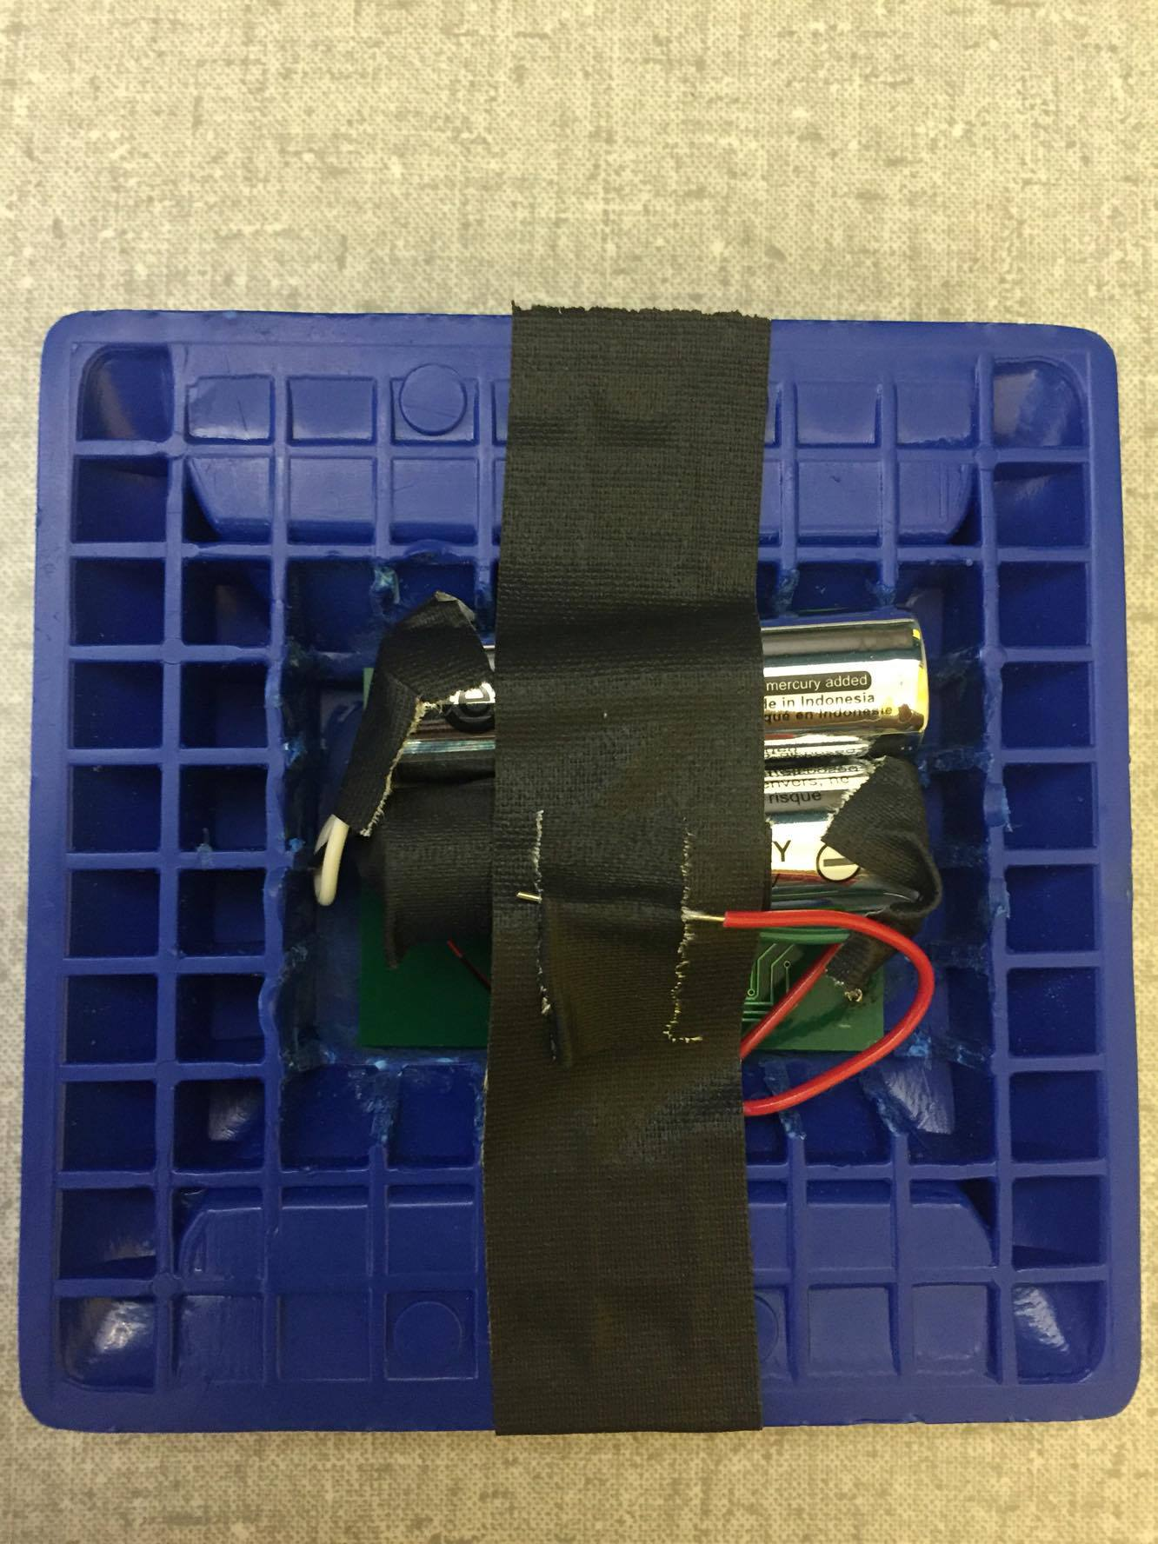
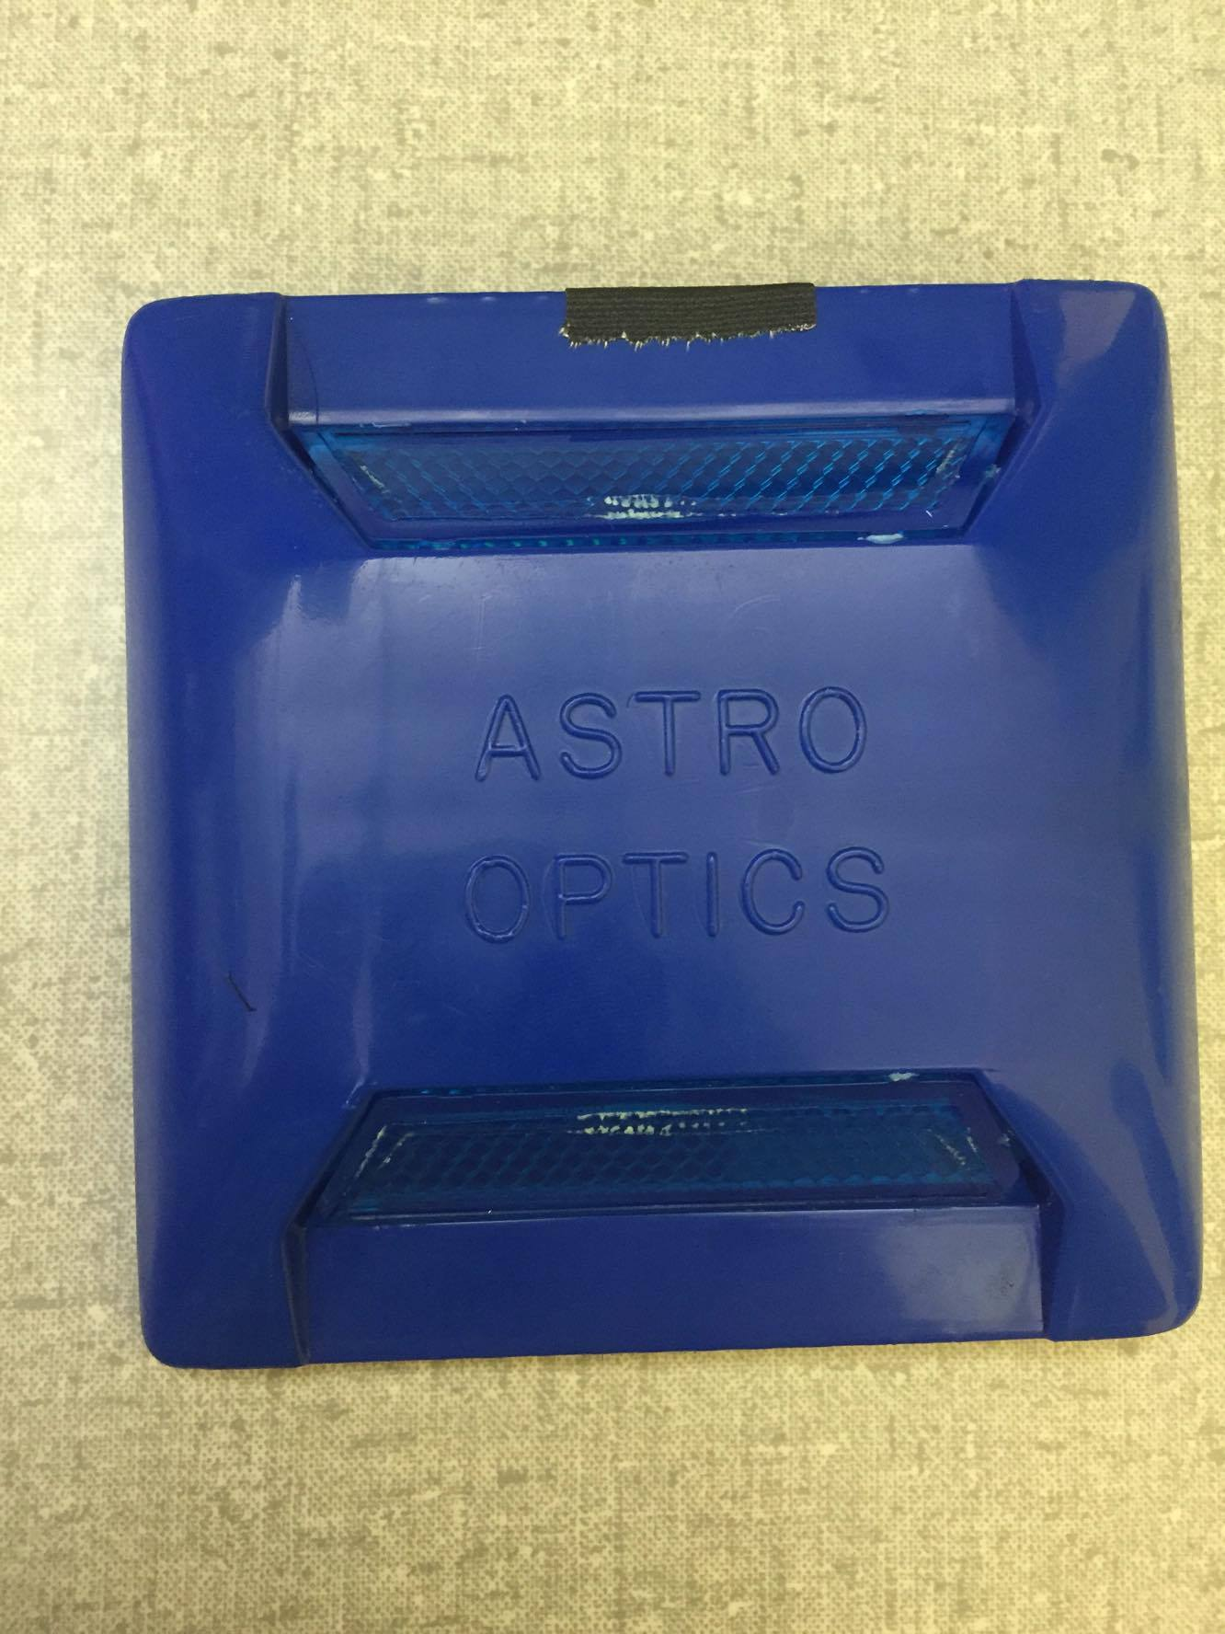
Final Look (prototype)

Slide 15
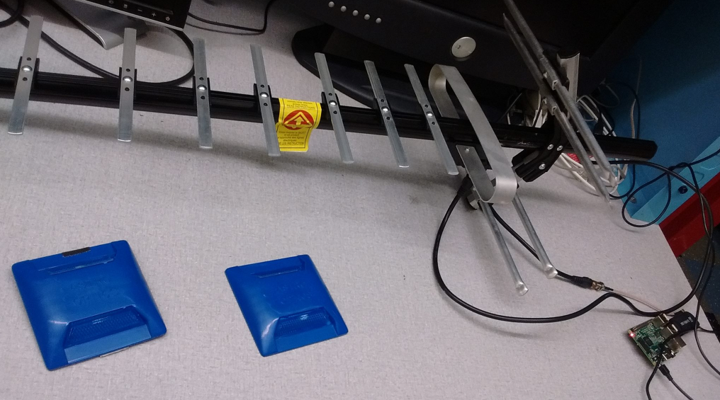
Overall Setup

Slide 16
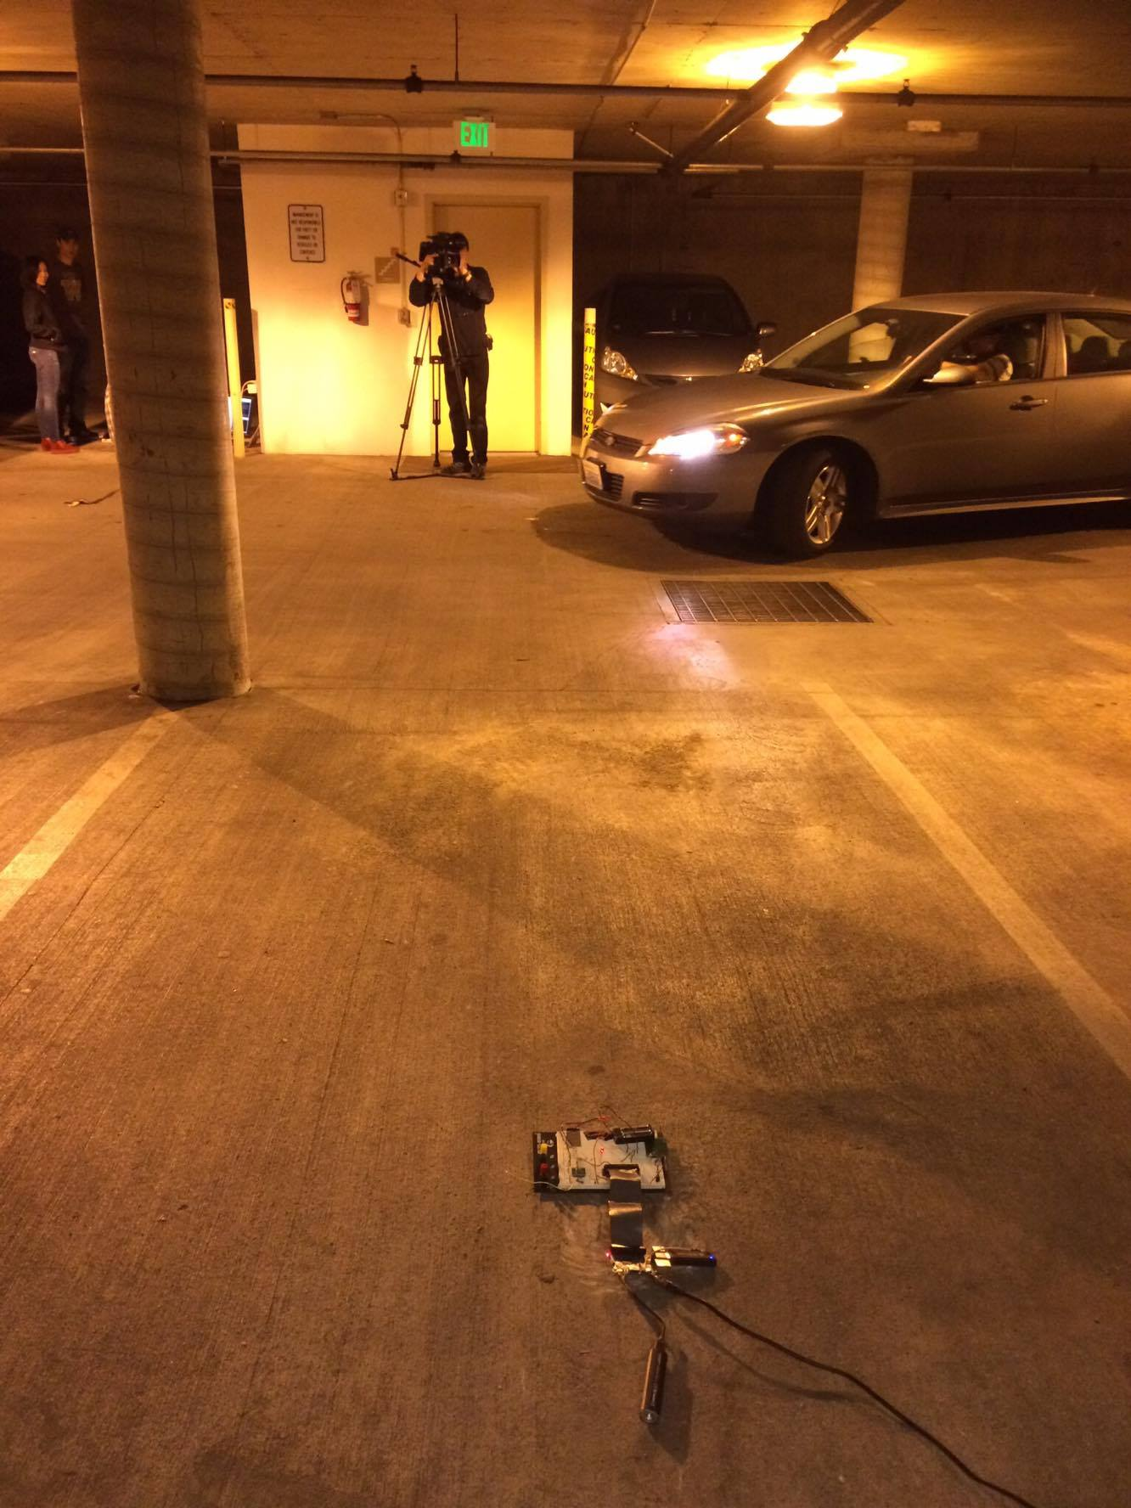
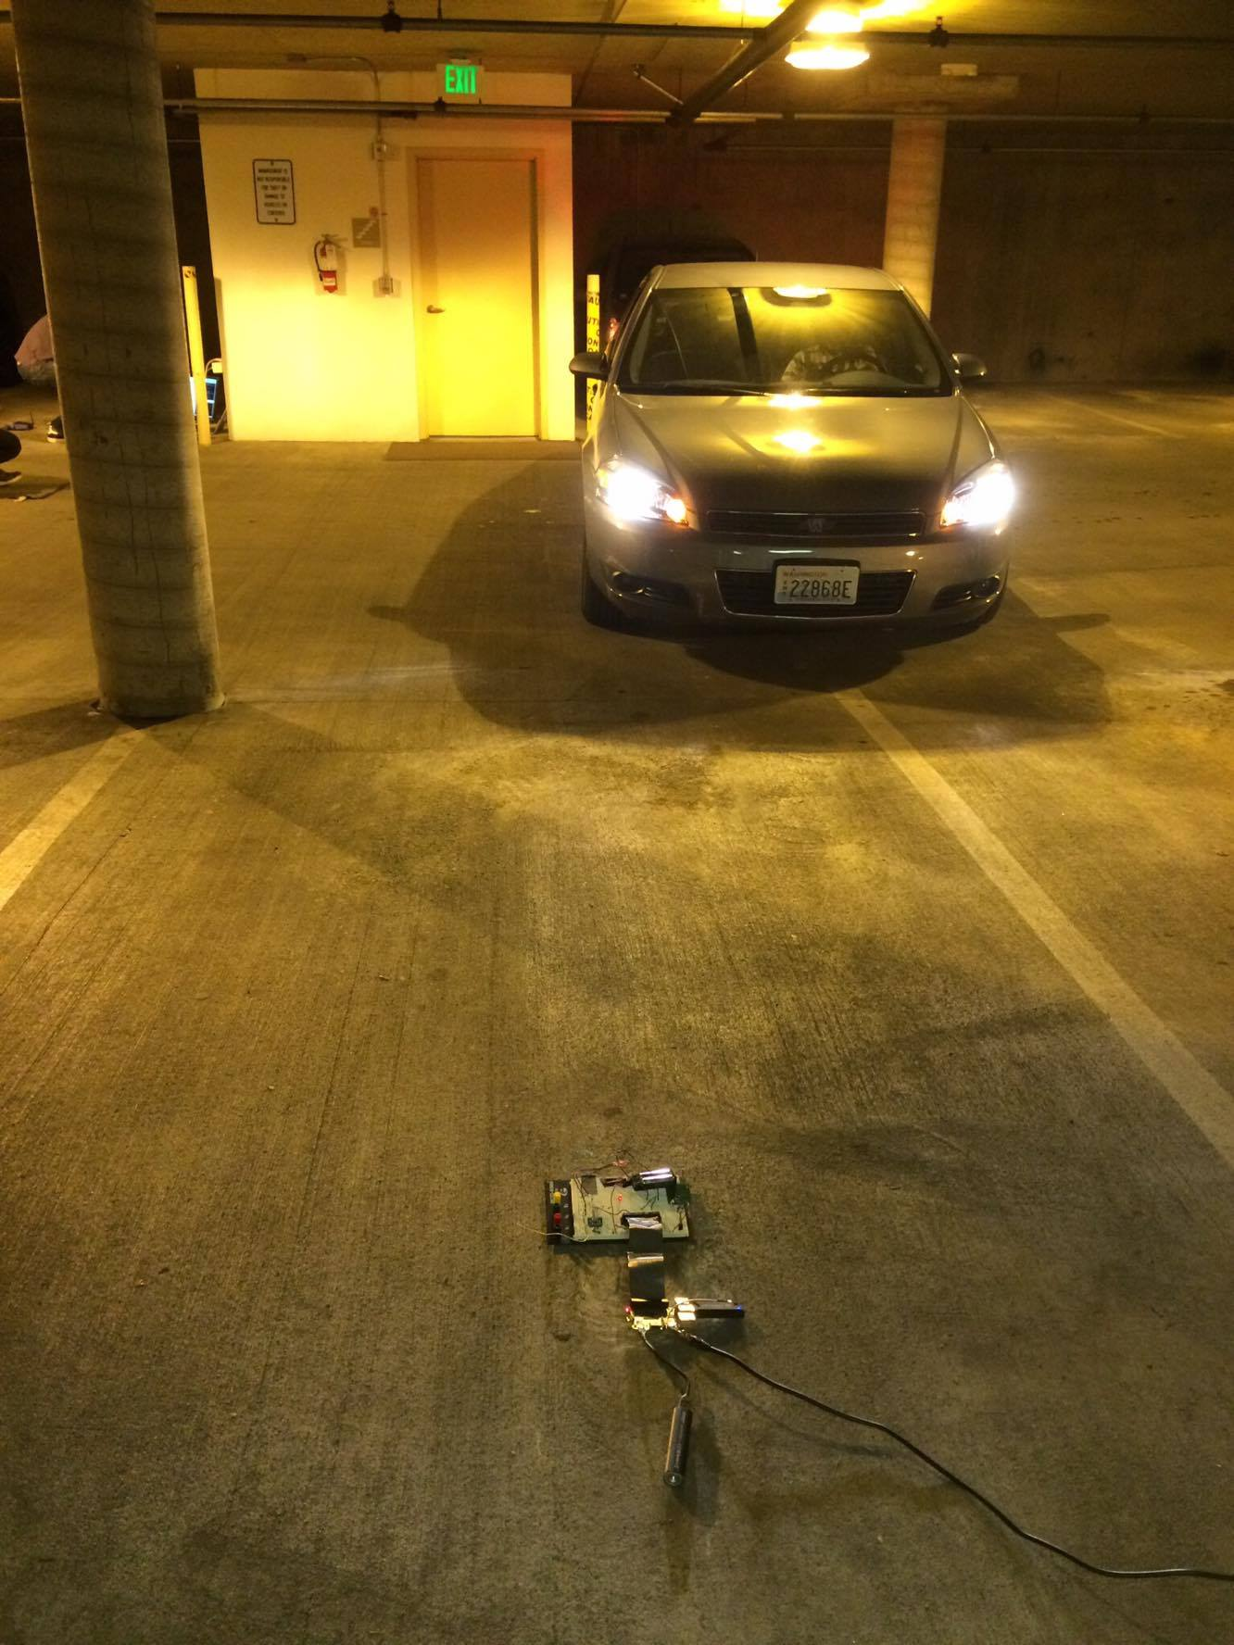
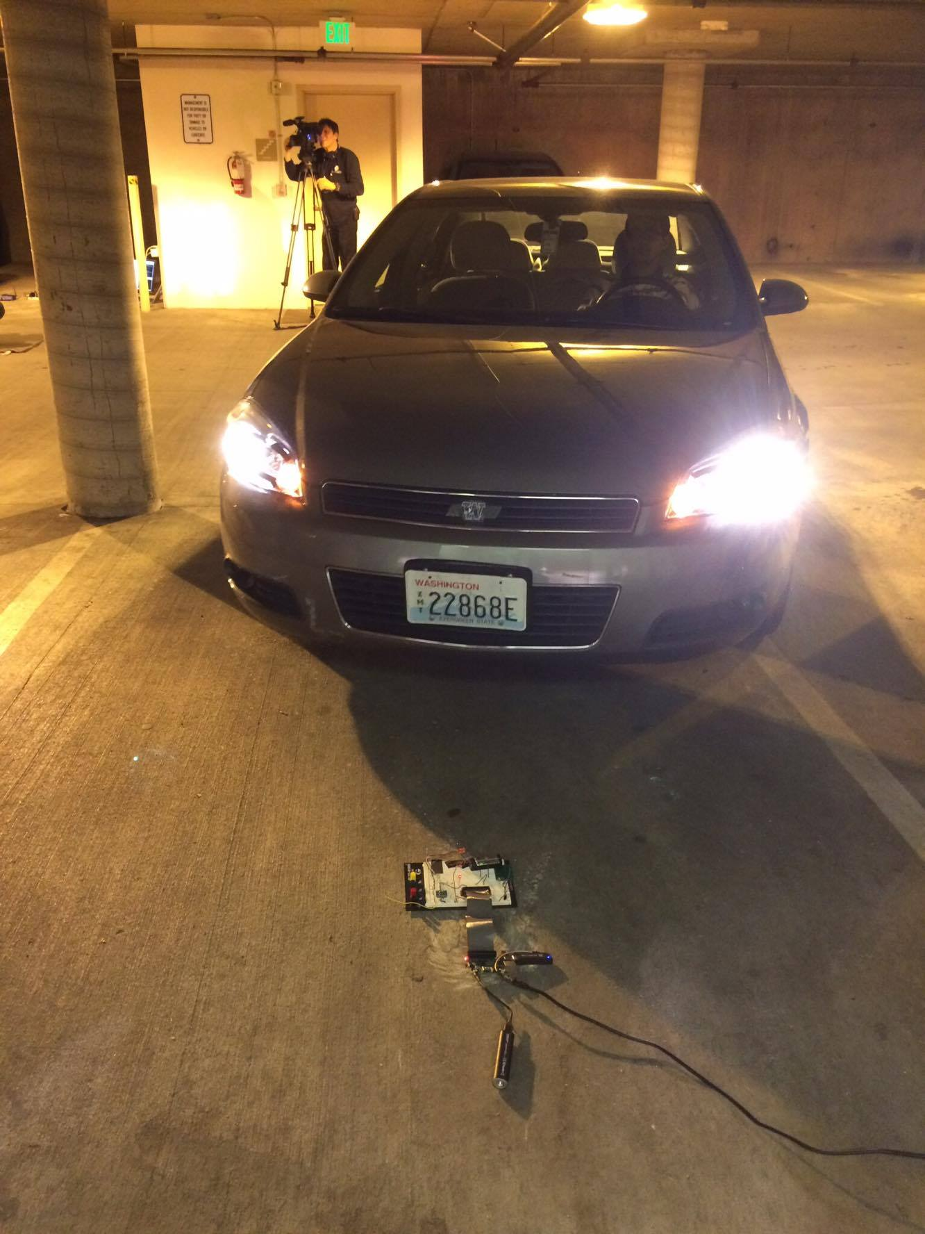
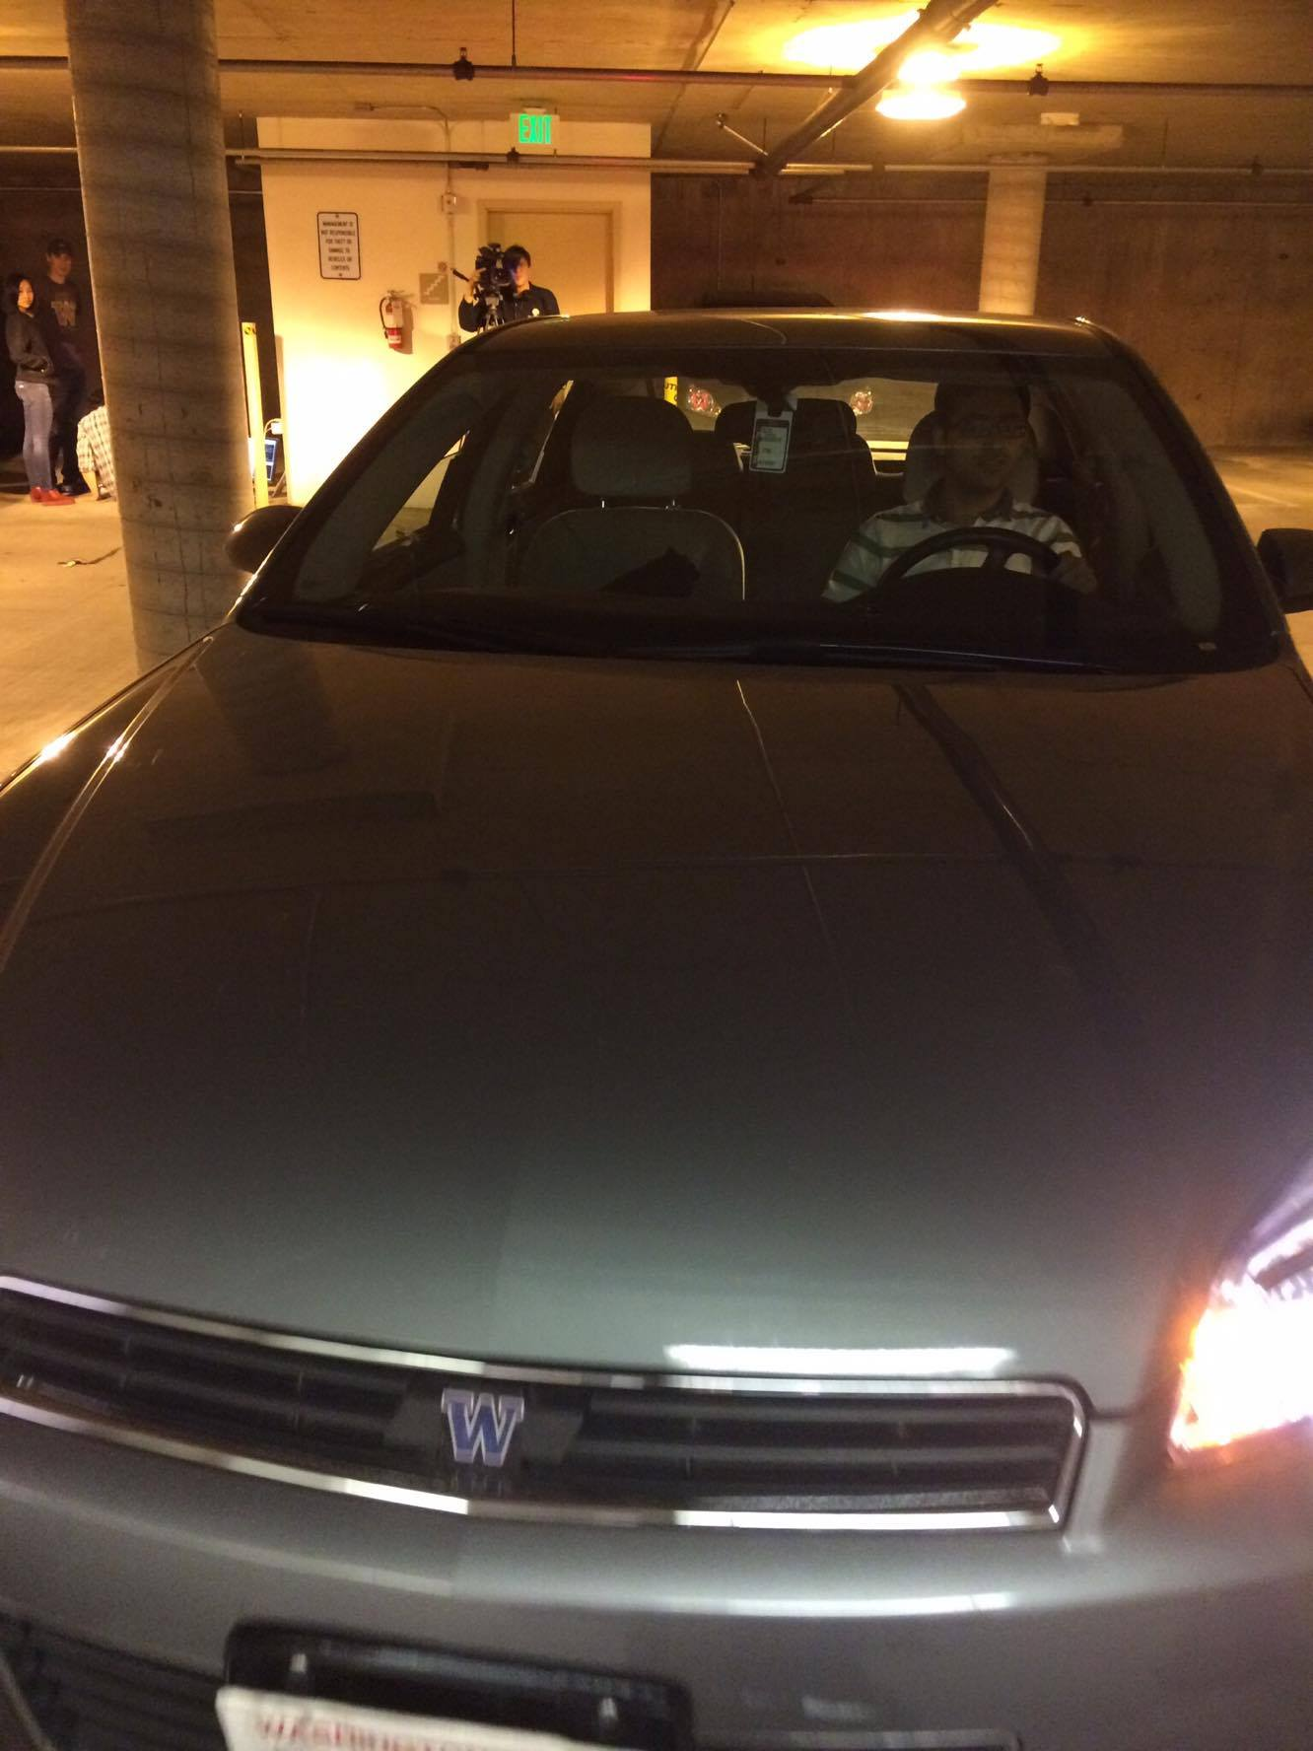
Capitol Hill Testing
Sensor accurately detected car state.
Radio communication was weak.
Notes:
a

Slide 17
Limitations and Assumptions: Magnetometer
Assumptions:
Vehicle must be metal of some kind
Vehicle height is relatively low (less than 3 feet)
Vehicle drives over the sensor
Limitations:
If the car enters the parking spot from an unexpected direction
Signal strength weakens as the sensor is far away from the base station
PCB antenna only provided a range of 17 meters (untuned)
Vehicle on top of the sensor interferes signal strength

Slide 18
Advantages
Approximate cost per system is $10 per parking spot.
Long battery life: ~1.4 years waking up every 5 minutes on two AAA batteries.
Standby mode consumes 1.33 uA
We can see all the parking spots available in real-time
System can detect cars as well as motorcycles
Easy installation/replacement – system can be insert underneath a traffic reflector.
Notes:
.017A .5 seconds
.031A .5 seconds
1 second 3.0v = .024A = 24mA for 1 second when transmitting
1.33uA si4010 and Magnetometer standby
5min wakeup 24mA every 5min for 1 seconds
5 min = 300 seconds
(299/300) 1.33uA + (1/300) 24mA = Avg Amps = 81.3256uA for 5min wakeup
AAA capacity = 1000 mAh
1000e-3 / 81.3256e-6 = 12296.25hours
1.40368 years.

Slide 19
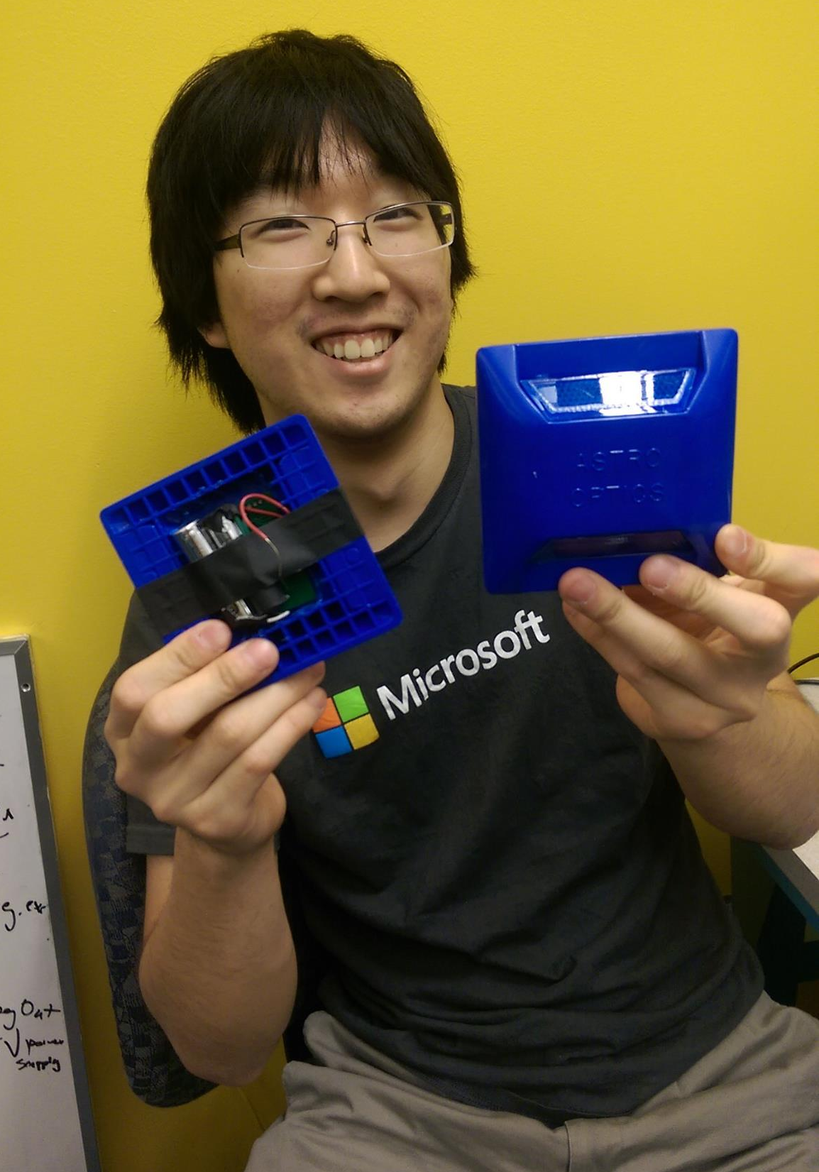
Questions?

